Slide 1
CS162 Operating Systems and Systems Programming Lecture 1 What is an Operating System?
January 19th, 2021
Profs. Natacha Crooks and Anthony D. Joseph
http://cs162.eecs.Berkeley.edu

Slide 2
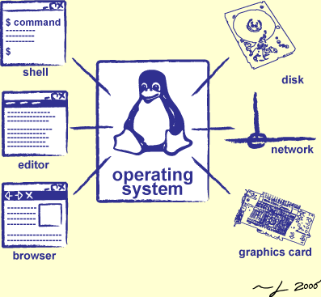
Goals for Today
What is an Operating System?
And – what is it not?
What makes Operating Systems so exciting?
Oh, and “How does this class operate?”
Slides courtesy of David Culler, Anthony D. Joseph, John Kubiatowicz, AJ Shankar, George Necula, Alex Aiken, Eric Brewer, Ras Bodik, Ion Stoica, Doug Tygar, and David Wagner.

Slide 3
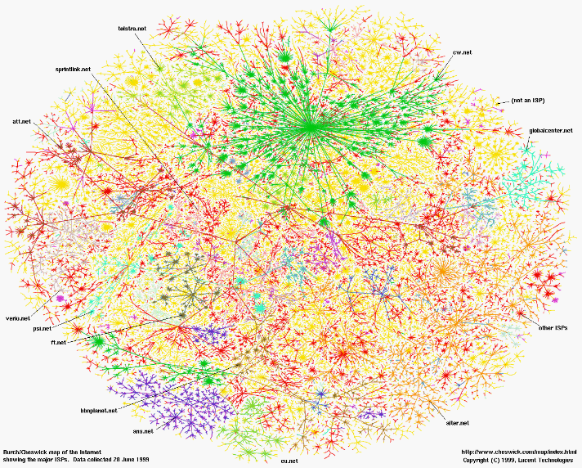
Greatest Artifact of Human Civilization…

Slide 4
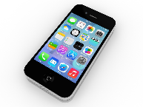
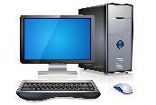

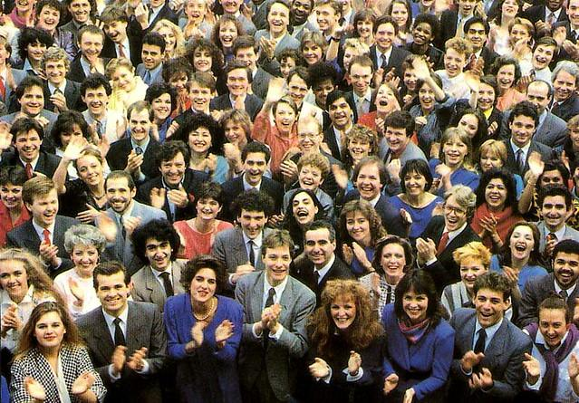
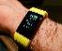
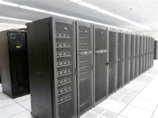
Greatest Artifact of Human Civilization…
The Internet!

Slide 5
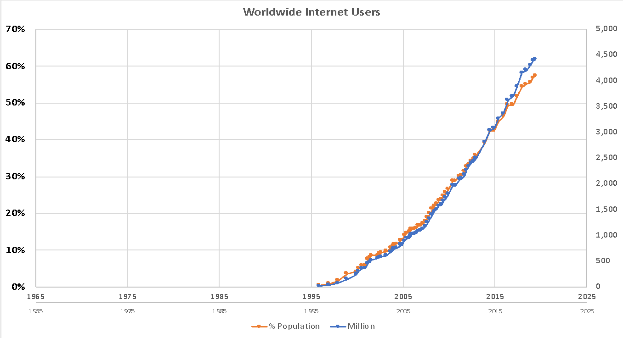
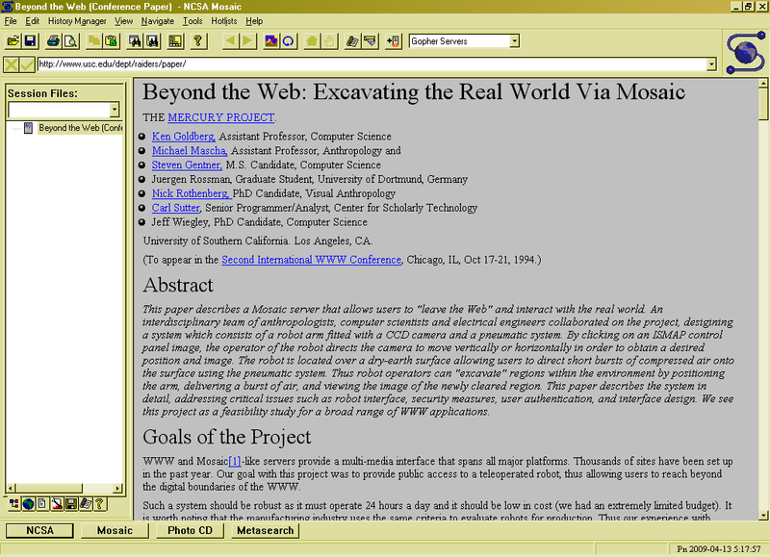
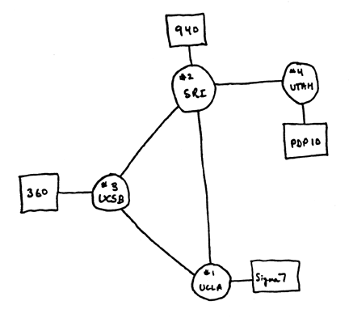
Running Systems at Internet Scale
Internet
WWW
RFC 675 TCP/IP
ARPANet
HTTP 0.9
1969
1974
1990

Slide 6
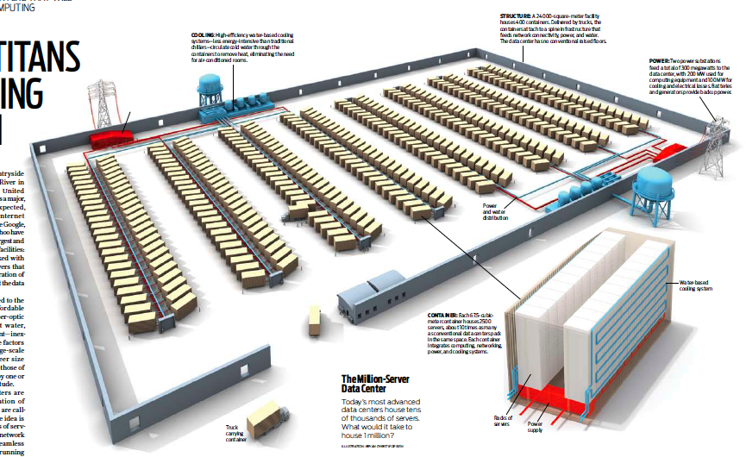
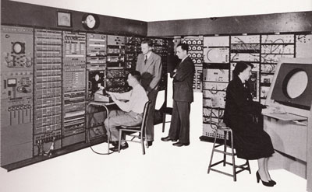
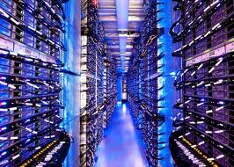
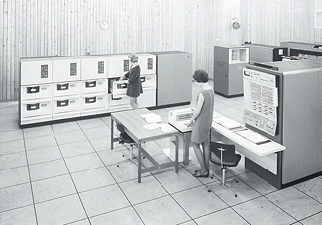
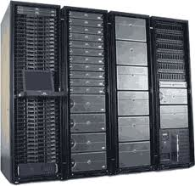
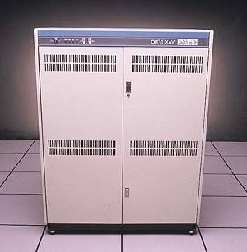
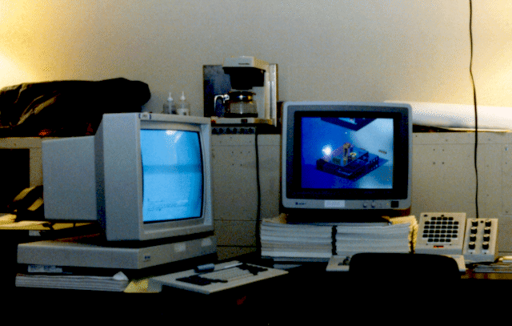
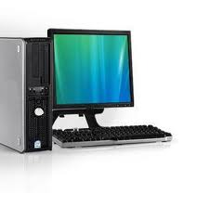
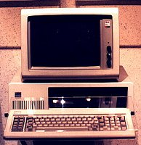
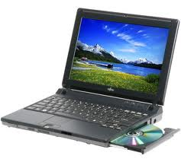
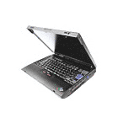
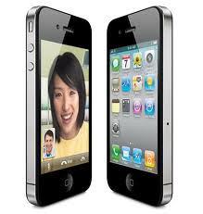
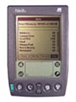
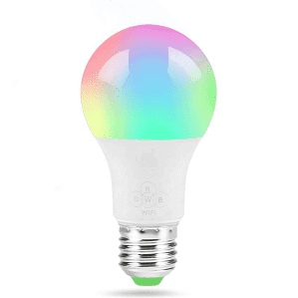

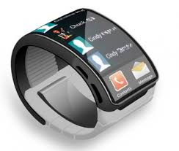
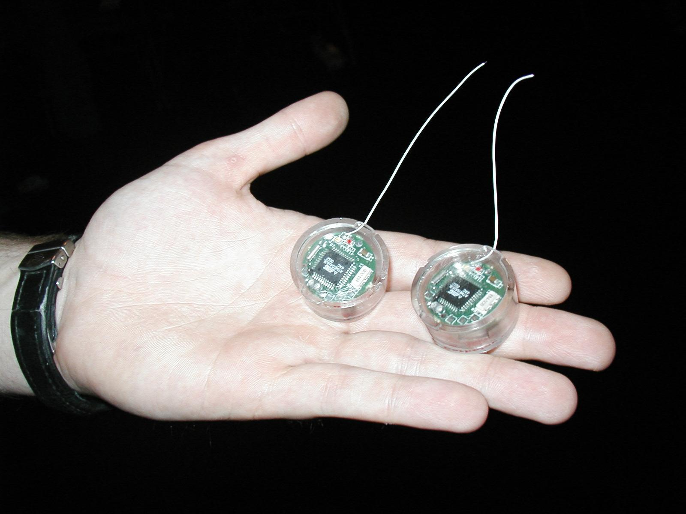
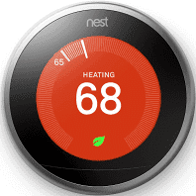

Across Incredible Diversity
Computers
Per Person
Number crunching, Data Storage, Massive Inet Services,
ML, …
1:10⁶
Mainframe
Bell’s Law: New computer class every 10 years
Mini
1:10³
Workstation
Productivity,
Interactive
PC
Laptop
1:1
PDA
Cell
Streaming from/to the physical world
10³:1
years
Mote!
The Internet of Things!

Slide 7
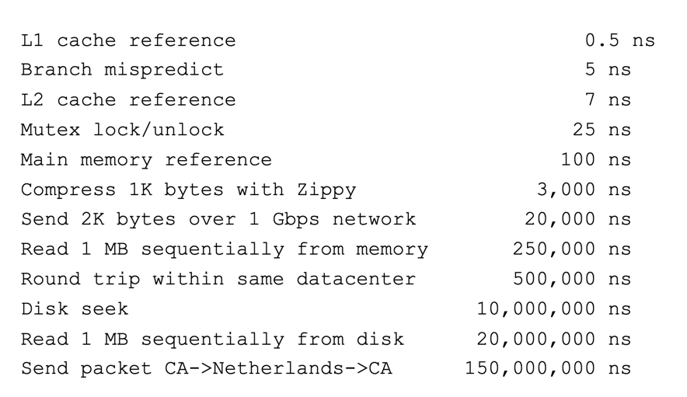
And Range of Timescales
Jeff Dean: “Numbers Everyone Should Know”

Slide 8
Operating Systems are at the Heart of it All!
Make the incredible advance in the underlying technology available to a rapidly evolving body of applications
Provide consistent abstractions to applications, even on different hardware
Manage sharing of resources among multiple applications
The key building blocks:
Processes
Threads, Concurrency, Scheduling, Coordination
Address Spaces
Protection, Isolation, Sharing, Security
Communication, Protocols
Persistent storage, transactions, consistency, resilience
Interfaces to all devices

Slide 9
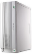
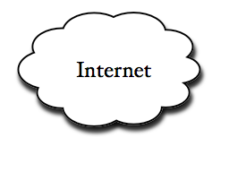
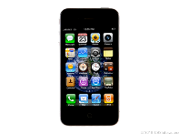
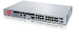
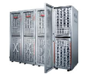
Example: What’s in a Search Query?
DNS
Servers
Datacenter
DNS
request
create
result
page
Search
Index
Page store
Load
balancer
Ad Server
Complex interaction of multiple components in multiple administrative domains
Systems, services, protocols, …
Notes:
In this course we are not focusing on a single node system but on the end-to-end system. The reason is very simple: today the majority of applications we use does not run on our system. Social networks, e-mail, google docs, online gamming, etc.

Slide 11
But: What is an operating system?

Slide 12
What does an Operating System do?
Most Likely:
Memory Management
I/O Management
CPU Scheduling
Communications? (Does Email belong in OS?)
Multitasking/multiprogramming?
What about?
File System?
Multimedia Support?
User Interface?
Internet Browser? ☺
Is this only interesting to Academics??

Slide 13
Definition of an Operating System
No universally accepted definition
“Everything a vendor ships when you order an operating system” is good approximation
But varies wildly
“The one program running at all times on the computer” is the kernel
Everything else is either a system program (ships with the operating system) or an application program

Slide 14
One Definition of an Operating System
Special layer of software that provides application software access to hardware resources
Convenient abstraction of complex hardware devices
Protected access to shared resources
Security and authentication
Communication
appln
appln
appln
OS
Hardware

Slide 15
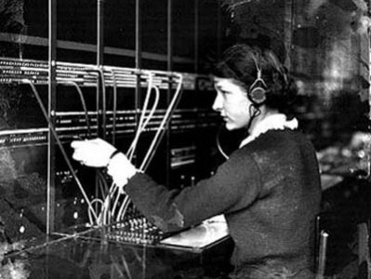
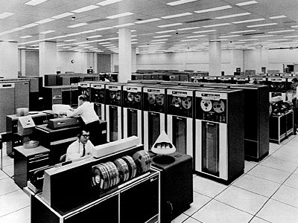
Operating System
Operating System
Switchboard Operator
Computer Operators

Slide 16
Operating System
What makes something a system?
Multiple interrelated parts
Each potentially interacts with the others
Robustness requires an engineering mindset
Meticulous error handling, defending against malicious and careless users
Treating the computer as a concrete machine, with all of its limitations and possible failure cases
System programming is an important part of this class!

Slide 18
What is an operating system? Illusionist

Slide 19
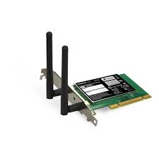
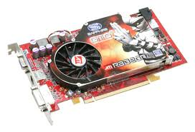
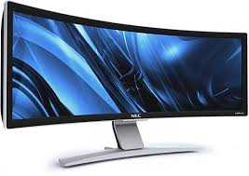

Hardware/Software Interface
Running Program
Software
What you learned in CS 61C – Machine Structures (and C)
Instruction Set Architecture (ISA)
Hardware
Memory
Page Table
& TLB
Processor
Cache
OS Memory
Networks
The OS abstracts these hardware details from the application
Ctrlr
Storage
Displays
Inputs

Slide 20

What is an Operating System?
Illusionist
Provide clean, easy-to-use abstractions of physical resources
Infinite memory, dedicated machine
Higher level objects: files, users, messages
Masking limitations, virtualization

Slide 21
OS Basics: Virtualizing the Machine
Compiled
Program
System Libs
Process: Execution environment with restricted rights provided by OS
Threads
Address Spaces
Files
Sockets
Operating System
ISA
Processor
PgTbl
& TLB
Storage
Networks
Memory
Hardware
OS Mem
I/O Ctrlr

Slide 22
Compiled Program’s View of the World
Compiled
Program
System Libs
Process: Execution environment with restricted rights provided by OS
Threads
Address Spaces
Files
Sockets
Operating System
ISA
Application’s “machine” is the process abstraction provided by the OS
Each running program runs in its own process
Processes provide nicer interfaces than raw hardware
Processor
PgTbl
& TLB
Storage
Networks
Memory
Hardware
OS Mem
I/O Ctrlr

Slide 23
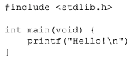
System Programmer’s View of the World
Program
System Libs
Linker
Compiler
Process: Execution environment with restricted rights provided by OS
Threads
Address Spaces
Files
Sockets
Operating System
ISA
Application’s “machine” is the process abstraction provided by the OS
Each running program runs in its own process
Processes provide nicer interfaces than raw hardware
Processor
PgTbl
& TLB
Storage
Networks
Memory
Hardware
OS Mem
I/O Ctrlr

Slide 24
What’s in a Process?
A process consists of:
Address Space
One or more threads of control executing in that address space
Additional system state associated with it
Open files
Open sockets (network connections)
…

Slide 25
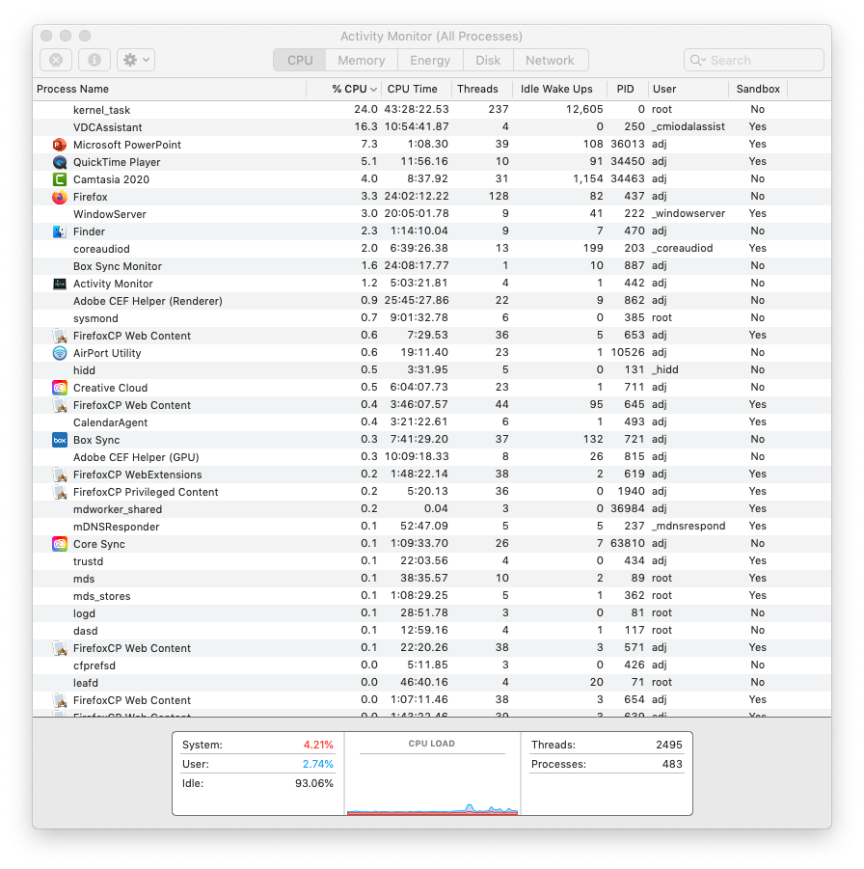
For Example…

Slide 26
Operating System’s View of the World
Compiled
Program 1
Compiled
Program 2
System Libs
System Libs
Compiler
Process 1
Process 2
Threads
Address Spaces
Files
Sockets
Threads
Address Spaces
Files
Sockets
Operating System
ISA
Processor
PgTbl
& TLB
Storage
Networks
Memory
Hardware
OS Mem
I/O Ctrlr

Slide 27
Operating System’s View of the World
Running
Program 1
Running
Program 2
OS translates from hardware interface to application interface
OS provides each running program with its own process
System Libs
System Libs
Compiler
Process 1
Process 2
Threads
Address Spaces
Files
Sockets
Threads
Address Spaces
Files
Sockets
Operating System
ISA
Processor
PgTbl
& TLB
Storage
Networks
Memory
Hardware
OS Mem
I/O Ctrlr

Slide 29
What is an operating system? Referee

Slide 30

What is an Operating System?
Referee
Manage protection, isolation, and sharing of resources
Resource allocation and communication
Illusionist
Provide clean, easy-to-use abstractions of physical resources
Infinite memory, dedicated machine
Higher level objects: files, users, messages
Masking limitations, virtualization

Slide 31
OS Basics: Running a Process
Compiled
Program 1
Compiled
Program 2
System Libs
System Libs
Compiler
Process 1
Process 2
Threads
Address Spaces
Files
Sockets
Threads
Address Spaces
Files
Sockets
Operating System
ISA
Processor
PgTbl
& TLB
Storage
Networks
Memory
Hardware
I/O Ctrlr

Slide 32
OS Basics: Switching Processes
Compiled
Program 1
Compiled
Program 2
System Libs
System Libs
Compiler
Process 1
Process 2
Threads
Address Spaces
Files
Sockets
Threads
Address Spaces
Files
Sockets
Operating System
ISA
Processor
PgTbl
& TLB
Storage
Networks
Memory
Hardware
OS
Mem
I/O Ctrlr

Slide 33
OS Basics: Switching Processes
Compiled
Program 1
Compiled
Program 2
System Libs
System Libs
Compiler
Process 1
Process 2
Threads
Address Spaces
Files
Sockets
Threads
Address Spaces
Files
Sockets
Operating System
ISA
Processor
PgTbl
& TLB
Storage
Networks
Memory
Hardware
OS
Mem
I/O Ctrlr

Slide 34
OS Basics: Switching Processes
Compiled
Program 1
Compiled
Program 2
System Libs
System Libs
Compiler
Process 1
Process 2
Threads
Address Spaces
Files
Sockets
Threads
Address Spaces
Files
Sockets
Operating System
ISA
Processor
PgTbl
& TLB
Storage
Networks
Memory
Hardware
OS
Mem
I/O Ctrlr

Slide 35
OS Basics: Switching Processes
Compiled
Program 1
Compiled
Program 2
System Libs
System Libs
Compiler
Process 1
Process 2
Threads
Address Spaces
Files
Sockets
Threads
Address Spaces
Files
Sockets
Operating System
ISA
Processor
PgTbl
& TLB
Storage
Networks
Memory
Hardware
OS
Mem
I/O Ctrlr

Slide 36
OS Basics: Protection
Compiled
Program 1
Compiled
Program 2
System Libs
System Libs
Compiler
Process 1
Process 2
Threads
Address Spaces
Files
Sockets
Threads
Address Spaces
Files
Sockets
Operating System
ISA
Processor
PgTbl
& TLB
Storage
Networks
Memory
Hardware
OS
Mem
I/O Ctrlr

Slide 37
OS Basics: Protection
Compiled
Program 1
Segmentation fault (core dumped)
Compiled
Program 2
System Libs
System Libs
Compiler
Process 1
Process 2
Threads
Address Spaces
Files
Sockets
Threads
Address Spaces
Files
Sockets
Operating System
ISA
Processor
PgTbl
& TLB
Storage
Networks
Memory
Hardware
OS
Mem
I/O Ctrlr

Slide 38
OS Basics: Protection
Process 1
Process 2
Process 3
OS isolates processes from each other
OS isolates itself from other processes
… even though they are actually running on the same hardware!
Software
OS Hardware Virtualization
Hardware
ISA
Memory
Processor
Protection Boundary
OS Memory
Ctrlr
Networks
Displays
Storage
Inputs

Slide 40
What is an operating system? Glue

Slide 41

What is an Operating System?
Referee
Manage protection, isolation, and sharing of resources
Resource allocation and communication
Illusionist
Provide clean, easy-to-use abstractions of physical resources
Infinite memory, dedicated machine
Higher level objects: files, users, messages
Masking limitations, virtualization
Glue
Common services
Storage, Window system, Networking
Sharing, Authorization
Look and feel

Slide 42
OS Basics: I/O
Process 1
Process 2
Process 3
Software
OS Hardware Virtualization
Hardware
ISA
Memory
OS provides common services in the form of I/O
Processor
Protection Boundary
OS Memory
Ctrlr
Networks
Displays
Storage
Inputs

Slide 43
OS Basics: Look and Feel
Compiled
Program
System Libs
Compiler
Process: Execution environment with restricted rights provided by OS
Threads
Address Spaces
Files
Sockets
Windows
Operating System
ISA
Processor
PgTbl
& TLB
Storage
Networks
Displays
Memory
Hardware
OS Mem
I/O Ctrlr

Slide 44
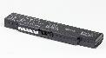
OS Basics: Background Management
Compiled
Program
System Libs
Compiler
Process: Execution environment with restricted rights provided by OS
Threads
Address Spaces
Files
Sockets
Windows
Operating System
Network Manager
Power Manager
ISA
Processor
PgTbl
& TLB
Storage
Networks
Displays
Battery
Memory
Hardware
OS Mem
I/O Ctrlr

Slide 45
What is an Operating System?
Referee
Manage protection, isolation, and sharing of resources
Resource allocation and communication
Illusionist
Provide clean, easy-to-use abstractions of physical resources
Infinite memory, dedicated machine
Higher level objects: files, users, messages
Masking limitations, virtualization
Glue
Common services
Storage, Window system, Networking
Sharing, Authorization
Look and feel

Slide 47
CS 162

Slide 48
Why take CS162?
Some of you will actually design and build operating systems or components of them.
Perhaps more now than ever
Many of you will create systems that utilize the core concepts in operating systems.
Whether you build software or hardware
The concepts and design patterns appear at many levels
All of you will build applications, etc. that utilize operating systems
The better you understand their design and implementation, the better use you’ll make of them.

Slide 49
Intros - Natacha Crooks
Assistant Professor in the Data Science and Foundation Group, EECS
PhD from UT Austin in 2019
Started in 2020, no physical office yet …
Research Areas
Distributed Systems, Databases, and Privacy-Preserving Systems

Slide 50
Intros - Anthony D. Joseph
Chancellor’s Professor in Electrical Engineering and Computer Science
465 Soda Hall (RISE Lab), http://www.cs.berkeley.edu/~adj/
Campus Cyber-Risk Responsible Executive, co-chair EECS dept IT committee
Research areas:
Modin (drop-in Pandas replacement), Fog Robotics (edge computing), Cancer Genomics/Precision Medicine (ADAM/Apache Spark), Secure Machine Learning (SecML), DETER security testbed
Previous: Cloud computing (Apache Mesos), Peer-to-Peer networking (Tapestry), Mobile computing, Wireless/Cellular networking
Outside Activities
Big Data and Apache Spark BerkeleyX MOOCs (‘15/’16 >240k students with >11% finishing)
Unite Genomics co-founder (focused on rare diseases treatments)

Slide 51


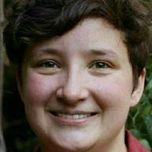



CS162 TAs: Sections TBA
Alina Dan
William Hsu
Eleanor Cawthon
Akshat Gokhale (Head TA)
Kevin Svetlitski
Allan Yu

Slide 52
Enrollment
Class has 310 limit
Unable to make class larger
This is an Early Drop Deadline course (January 29th)
If you are not serious about taking, please drop early
Department will continue to admit students as other students drop
Really hard to drop afterwards!
Don’t forget to keep up with work if you are still on the waitlist!
We are serious about requiring CAMERAs
Zoom proctoring of exams
Required sections, design reviews, interactions with your group (screen shots!)
This is part of keeping people from falling off into /dev/null in cyberspace!
On the waitlist/Concurrent enrollment ???
Unfortunately, we maxed out sections and TA Support
If people drop, we can move others off waitlist
Concurrent enrollment is after the waitlist

Slide 53
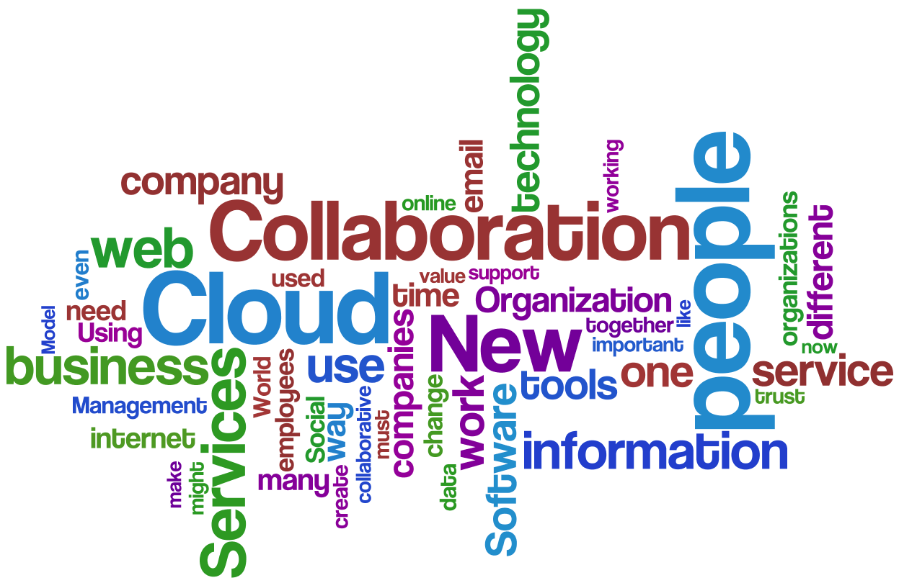
CS162 in the age of COVID-19

Slide 54
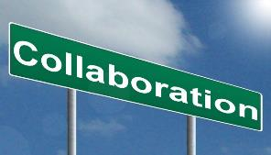




CS162 in the age of COVID-19
Well, things are considerably different this term!
Many lessons learned from the Spring/Summer/Fall semesters
Everything is remote – all term!
Most important thing: People, Interactions, Collaboration
How do we recover collaboration without direct interaction?
Remember group meetings?
Must Work to bring everyone along (virtually)!
Cameras are essential components of this class
Must have a camera and plan to turn it on
Will need it for exams, discussion sections, design reviews, OH
Need to bring back personal interaction – even if it is virtual
Humans not good at interacting text-only
Virtual coffee hours with your group (camera turned on!)
Required attendance at: Discussion sections, Design Reviews
With camera turned on!
Hello!
Hi!

Slide 55
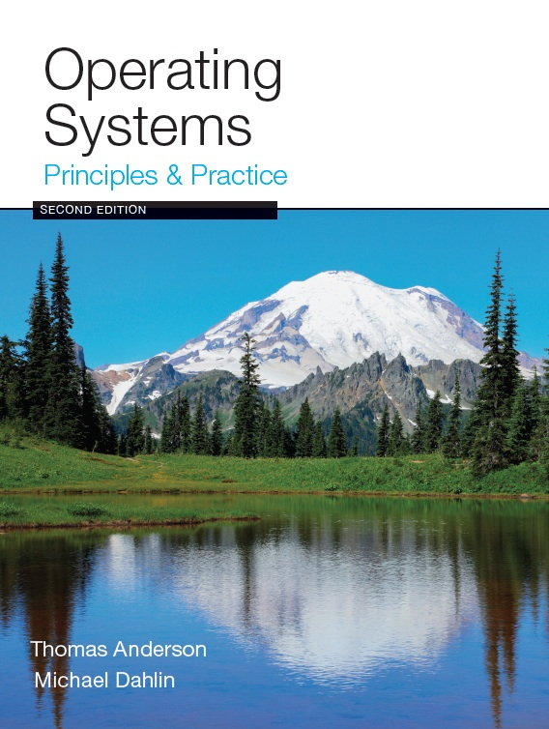
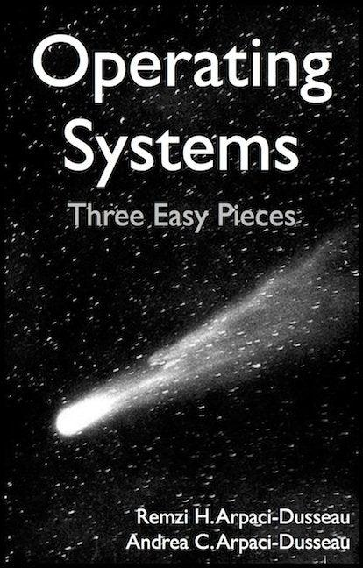
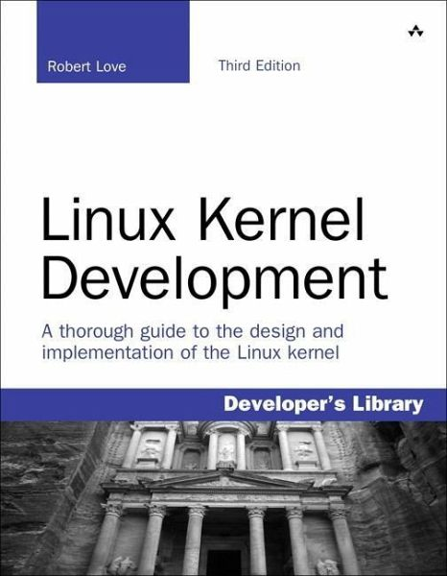
Infrastructure, Textbook & Readings
Infrastructure
Website: http://cs162.eecs.berkeley.edu
Piazza: https://piazza.com/berkeley/spring2021/cs162
Pre-recorded Lectures, Some Live Lectures (recordings available next day)
Textbook: Operating Systems: Principles and Practice (2nd Edition) Anderson and Dahlin
Suggested readings posted along with lectures
Try to keep up with material in book as well as lectures
Supplementary Material
Operating Systems: Three Easy Pieces, by Remzi and Andrea Arpaci-Dusseau, available for free online
Linux Kernel Development, 3rd edition, by Robert Love
Online supplements
See course website
Includes Appendices, sample problems, etc.
Networking, Databases, Software Engineering, Security
Some Research Papers!

Slide 56
Syllabus
OS Concepts: How to Navigate as a Systems Programmer!
Process, I/O, Networks and Virtual Machines
Concurrency
Threads, scheduling, locks, deadlock, scalability, fairness
Address Space
Virtual memory, address translation, protection, sharing
File Systems
I/O devices, file objects, storage, naming, caching, performance, paging, transactions, databases
Distributed Systems
Protocols, N-Tiers, RPC, NFS, DHTs, Consistency, Scalability, multicast
Reliability & Security
Fault tolerance, protection, security
Cloud Infrastructure

Slide 57


Learning by Doing
Individual Homeworks (2 weeks) - preliminary
0. Tools & Environment, Autograding, recall C, executable
1. Lists in C
2. BYOS – build your own shell
3. Memory allocation (MALLOC)
4. Memory management
5. Sockets & Threads in HTTP server
Three (and ½) Group Projects
0. Getting Started (Individual, before you have a group)
1. User-programs (exec & syscall)
2. Threads & Scheduling
3. File Systems

Slide 58
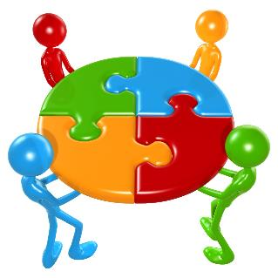
Group Projects
Project teams have 4 members!
Never 5, 3 requires serious justification
Must work in groups in “the real world”
Same section (at least same TA)
Communication and cooperation will be essential
Regular meetings WITH CAMERA TURNED ON!
Extra credit for screen shots of all of you together in zoom with camera enabled
Design Documents
Slack/Messenger/whatever doesn’t replace face-to-face!
Everyone should do work and have clear responsibilities
You will evaluate your teammates at the end of each project
Dividing up by Task is the worst approach. Work as a team.
Communicate with supervisor (TAs)
What is the team’s plan?
What is each member’s responsibility?
Short progress reports are required
Design Documents: High-level description for a manager!

Slide 59
Getting started
Time-zone Survey!
We need to know where you are so that we can plan section/midterm times
Start homework 0 and Project 0 right away (hopefully Today!)
Github account
Registration survey
Vagrant virtualbox – VM environment for the course
Consistent, managed environment on your machine
Get familiar with all the cs162 tools
Submit to autograder via git
Sections on Friday – attend any section you want
We’ll assign permanent sections after forming project groups
Section attendance will be mandatory after we form groups
These section times will be adjusted after we have a better idea where people are

Slide 60
Preparing Yourself for this Class
The projects will require you to be very comfortable with programming and debugging C
Pointers (including function pointers, void*)
Memory Management (malloc, free, stack vs heap)
Debugging with GDB
You will be working on a larger, more sophisticated code base than anything you've likely seen in 61C!
Review Session on C/C++:
Monday, 1/25, Time and logistics TBA
"Resources" page on course website
Ebooks on “git” and “C”
C programming reference (still in beta):
https://cs162.eecs.berkeley.edu/ladder/
First two sections are also dedicated to programming and debugging review:
Attend ANY sections in first two weeks

Slide 61
Grading (Tentative breakdown)
36% three midterms (12% each)
Thursday, 2/18, TBA, time set after survey
Thursday, 3/18, TBA, time set after survey
Thursday, 4/29, TBA, time set after survey
These will be ZOOM-Proctored. Camera REQUIRED.
36% projects
18% homework
10% participation (Sections, Lecture, …)
No final exam
Projects
Initial design document, Design review, Code, Final design
Submission via git push triggers autograder

Slide 62
Personal Integrity
UCB Academic Honor Code: "As a member of the UC Berkeley community, I act with honesty, integrity, and respect for others."
https://asuc.org/honor-code-landing/

Slide 63


CS 162 Collaboration Policy
Explaining a concept to someone in another group
Discussing algorithms/testing strategies with other groups
Discussing debugging approaches with other groups
Searching online for generic algorithms (e.g., hash table)
Sharing code or test cases with another group
Copying OR reading another group’s code or test cases
Copying OR reading online code or test cases from prior years
Helping someone in another group to debug their code
We compare all project submissions against prior year submissions and online solutions and will take actions (described on the course overview page) against offenders
Don’t put a friend in a bad position by asking for help that they shouldn’t give!

Slide 65
What makes Operating Systems Exciting and Challenging?

Slide 66
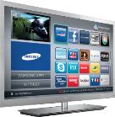
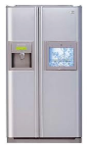









Societal Scale Information Systems (Or the “Internet of Things”?)
Massive Cluster
The world is a large distributed system
Microprocessors in everything
Vast infrastructure behind them
Gigabit Ethernet
Clusters
Massive Cluster
Clusters
Gigabit Ethernet
Internet Connectivity
Scalable, Reliable,
Secure Services
Databases
Information Collection
Remote Storage
Online Games
Commerce
…
MEMS for
Sensor Nets
Notes:
Of the enormous variety of CITRIS projects going on at Berkeley, I will present one set that is tied together by this picture: the design, construction and use of MEMS devices, the sensor networks containing them, and making the information from these networks available to widely distributed users as scalable, reliable and secure services.
The name we give to such an integrated system is a Societal Scale Information System, a name meant to evoke its scale – enormous - and purpose – benefiting people and the economy.
I will leave the details of all the specific applications that Ruzena mentioned, be it to energy efficiency or education or disaster response the social sciences, and indeed most details, to later talks and posters.

Slide 67



Technology Trends: Moore’s Law
Moore’s Law
2X transistors/Chip Every 1.5 years
Called “Moore’s Law”
Gordon Moore (co-founder of Intel) predicted in 1965 that the transistor density of semiconductor chips would double roughly every 18 months
Microprocessors have become smaller, denser, and more powerful

Slide 68

Big Challenge: Slowdown in Joy’s law of Performance
3X
From Hennessy and Patterson, Computer Architecture: A Quantitative Approach, 4th edition, Sept. 15, 2006
⇒ Sea change in chip design: multiple “cores” or processors per chip
VAX : 25%/year 1978 to 1986
RISC + x86 : 52%/year 1986 to 2002
RISC + x86 : ??%/year 2002 to present

Slide 69

Another Challenge: Power Density
Moore’s law extrapolation
Potential power density reaching amazing levels!
Flip side: battery life very important
Moore’s law yielded more functionality at equivalent (or less) total energy consumption

Slide 70


ManyCore Chips: The future arrived in 2007
Intel 80-core multicore chip (Feb 2007)
80 simple cores
Two FP-engines / core
Mesh-like network
100 million transistors
65nm feature size
Intel Single-Chip Cloud Computer (August 2010)
24 “tiles” with two cores/tile
24-router mesh network
4 DDR3 memory controllers
Hardware support for message-passing
How to program these?
Use 2 CPUs for video/audio
Use 1 for word processor, 1 for browser
76 for virus checking???
Parallelism must be exploited at all levels
Amazon X1 instances (2016)
128 virtual cores, 2 TB RAM

Slide 71

But then Moore’s Law Ended…
Moore’s Law has (officially) ended -- Feb 2016
No longer getting 2 x transistors/chip every 18 months…
or even every 24 months
May have only 2-3 smallest geometry fabrication plants left:
Intel and Samsung and/or TSMC
Vendors moving to 3D stacked chips
More layers in old geometries

Slide 72


Storage Capacity is Still Growing!

Slide 73


Society is Increasingly Connected…

Slide 74

Network Capacity Still Increasing
(source: http://www.ospmag.com/issue/article/Time-Is-Not-Always-On-Our-Side )
Notes:
Networking bandwidth is expected to also outpace the CPU power, so more bandwidth per core.

Slide 75

Not Only PCs connected to the Internet
In 2011, smartphone shipments exceeded PC shipments!
2011 shipments:
487M smartphones
414M PC clients
210M notebooks
112M desktops
63M tablets
25M smart TVs
4 billion phones in the world 🡪 smartphones over next few years
Then…
1.53B in 2017
262.5M in 2017
164M in 2017
39.5M in 2017

Slide 76
People-to-Computer Ratio Over Time
Computers
Per Person
Number crunching, Data Storage, Massive Inet Services,
ML, …
1:10⁶
Mainframe
Mini
1:10³
Workstation
Productivity,
Interactive
PC
Laptop
1:1
PDA
Cell
Streaming from/to the physical world
10³:1
years
Mote!
The Internet of Things!
Bell’s Law: new computer class per 10 years

Slide 78
What is an Operating System?

Slide 79



What is an Operating System Again?
Referee
Manage sharing of resources, Protection, Isolation
Resource allocation, isolation, communication
Illusionist
Provide clean, easy to use abstractions of physical resources
Infinite memory, dedicated machine
Higher level objects: files, users, messages
Masking limitations, virtualization
Glue
Common services
Storage, Window system, Networking
Sharing, Authorization
Look and feel

Slide 80
Challenge: Complexity
Applications consisting of…
… a variety of software modules that …
… run on a variety of devices (machines) that
… implement different hardware architectures
… run competing applications
… fail in unexpected ways
… can be under a variety of attacks
Not feasible to test software for all possible environments and combinations of components and devices
The question is not whether there are bugs but how serious are the bugs!

Slide 81

The World Is Parallel: Intel SkyLake (2017)
Up to 28 Cores, 56 Threads
694 mm² die size (estimated)
Many different instructions
Security, Graphics
Caches on chip:
L2: 28 MiB
Shared L3: 38.5 MiB (non-inclusive)
Directory-based cache coherence
Network:
On-chip Mesh Interconnect
Fast off-chip network directly supports 8-chips connected
DRAM/chips
Up to 1.5 TiB
DDR4 memory

Slide 82

HW Functionality comes with great complexity!
Intel Skylake-X
I/O Configuration
Proc
Caches
Busses
adapters
Memory
Controllers
Disks
Displays
Keyboards
I/O Devices:
Networks

Slide 83

Increasing Software Complexity
Millions of Lines of Code
(source https://informationisbeautiful.net/visualizations/million-lines-of-code/)

Slide 84


Example: Some Mars Rover (“Pathfinder”) Requirements
Pathfinder hardware limitations/complexity:
20Mhz processor, 128MB of DRAM, VxWorks OS
cameras, scientific instruments, batteries, solar panels, and locomotion equipment
Many independent processes work together
Can’t hit reset button very easily!
Must reboot itself if necessary
Must always be able to receive commands from Earth
Individual Programs must not interfere
Suppose the MUT (Martian Universal Translator Module) buggy
Better not crash antenna positioning software!
Further, all software may crash occasionally
Automatic restart with diagnostics sent to Earth
Periodic checkpoint of results saved?
Certain functions time critical:
Need to stop before hitting something
Must track orbit of Earth for communication
A lot of similarity with the Internet of Things?
Complexity, QoS, Inaccessbility, Power limitations … ?
Notes:
Distance 186 light secs to 21 light minutes one-way
Nearly two earth years

Slide 85
Questions
Does the programmer need to write a single program that performs many independent activities?
Does every program have to be altered for every piece of hardware?
Does a faulty program crash everything?
Does every program have access to all hardware?
Hopefully, no!
Operating Systems help the programmer write robust programs!

Slide 86
OS Abstracts the Underlying Hardware
Processor → Thread
Memory → Address Space
Disks, SSDs, … → Files
Networks → Sockets
Machines → Processes
OS as an Illusionist:
Remove software/hardware quirks (fight complexity)
Optimize for convenience, utilization, reliability, … (help the programmer)
For any OS area (e.g. file systems, virtual memory, networking, scheduling):
What hardware interface to handle? (physical reality)
What’s software interface to provide? (nicer abstraction)
Application
Operating System
Hardware
Abstract Machine Interface
Physical Machine Interface

Slide 87

OS Protects Processes and the Kernel
Run multiple applications and:
Keep them from interfering with or crashing the operating system
Keep them from interfering with or crashing each other

Slide 88

Basic Tool: Dual-Mode Operation
Hardware provides at least two modes:
Kernel Mode (or “supervisor” mode)
User Mode
Certain operations are prohibited when running in user mode
Changing the page table pointer, disabling interrupts, interacting directly w/ hardware, writing to kernel memory
Carefully controlled transitions between user mode and kernel mode
System calls, interrupts, exceptions

Slide 89

UNIX System Structure

Slide 90


Virtualization: Execution Environments for Systems
Additional layers of protection and isolation can help further manage complexity

Slide 91
What is an Operating System,… Really?
Most Likely:
Memory Management
I/O Management
CPU Scheduling
Communications? (Does Email belong in OS?)
Multitasking/multiprogramming?
What about?
File System?
Multimedia Support?
User Interface?
Internet Browser? ☺
Is this only interesting to Academics??

Slide 92
Operating System Definition (Cont.)
No universally accepted definition
“Everything a vendor ships when you order an operating system” is good approximation
But varies wildly
“The one program running at all times on the computer” is the kernel
Everything else is either a system program (ships with the operating system) or an application program

Slide 93
“In conclusion…Operating Systems:”
Provide convenient abstractions to handle diverse hardware
Convenience, protection, reliability obtained in creating the illusion
Coordinate resources and protect users from each other
Using a few critical hardware mechanisms
Simplify application development by providing standard services
Provide fault containment, fault tolerance, and fault recovery
CS162 combines things from many other areas of computer science:
Languages, data structures, hardware, and algorithms

